Slide 1


Slide 2
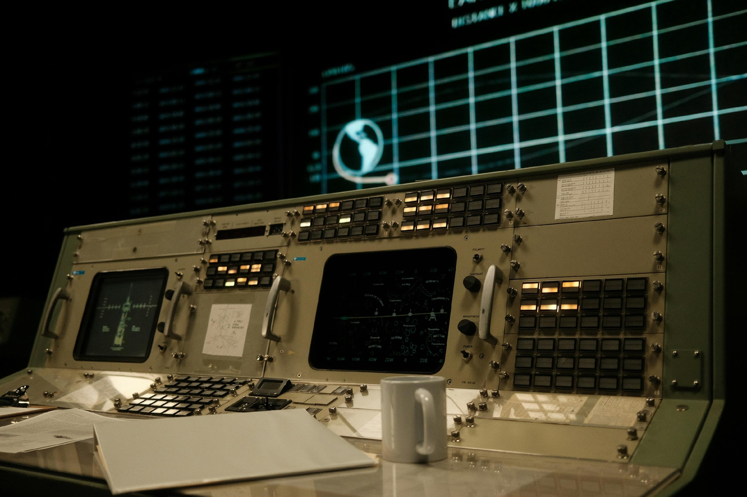

DMU
Hacking Society
Wireshark / EW

Slide 3




DMU HACKERS
D0nt d0 1ll3gal sh1t
please..

Slide 4
Announcements!
DMU HACKERS
Red v Blue in the week off
Internships open (gradcracker)
DMU Careers Fair 21st / 22nd

Slide 5
Today’s Session
DMU HACKERS
Electronic Warfare and why it is relevant to us
Some military EW capabilities
Brief intro to satellite bands and radio hardware
A side of conspiracy theories
Wireshark and packet analysis
A lovely practical

Slide 6
What is Electronic Warfare (EW)?
DMU HACKERS
Simply, Electronic Warfare and signals intelligence, is the collection and manipulation of DATA.
Turning signals data into useful intelligence
Denying the enemy use of the airwaves to disrupt their mission
Manipulating their signals to disrupt operations
Or, do what russia do, and jam everyone's GPS, why would they do this… Because they are c**ts.

Slide 7
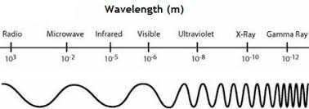
What is Electronic Warfare (EW)?
DMU HACKERS
Electronic warfare is the strategic use of the electromagnetic spectrum (EMS) to:
Detect
Intercept
Disrupt
Deceive
Deny
Destroy
An enemy’s electronic systems, targeting comms, radar and control systems.

Slide 8
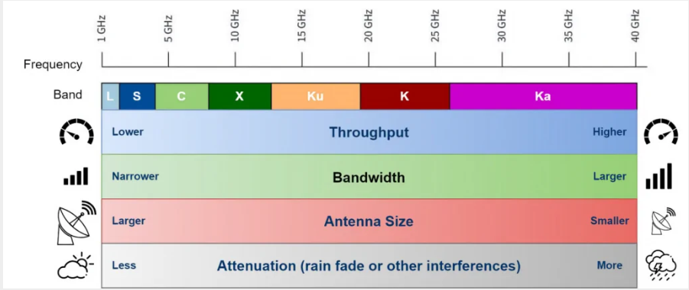
Satellite Bands
DMU HACKERS

Slide 9
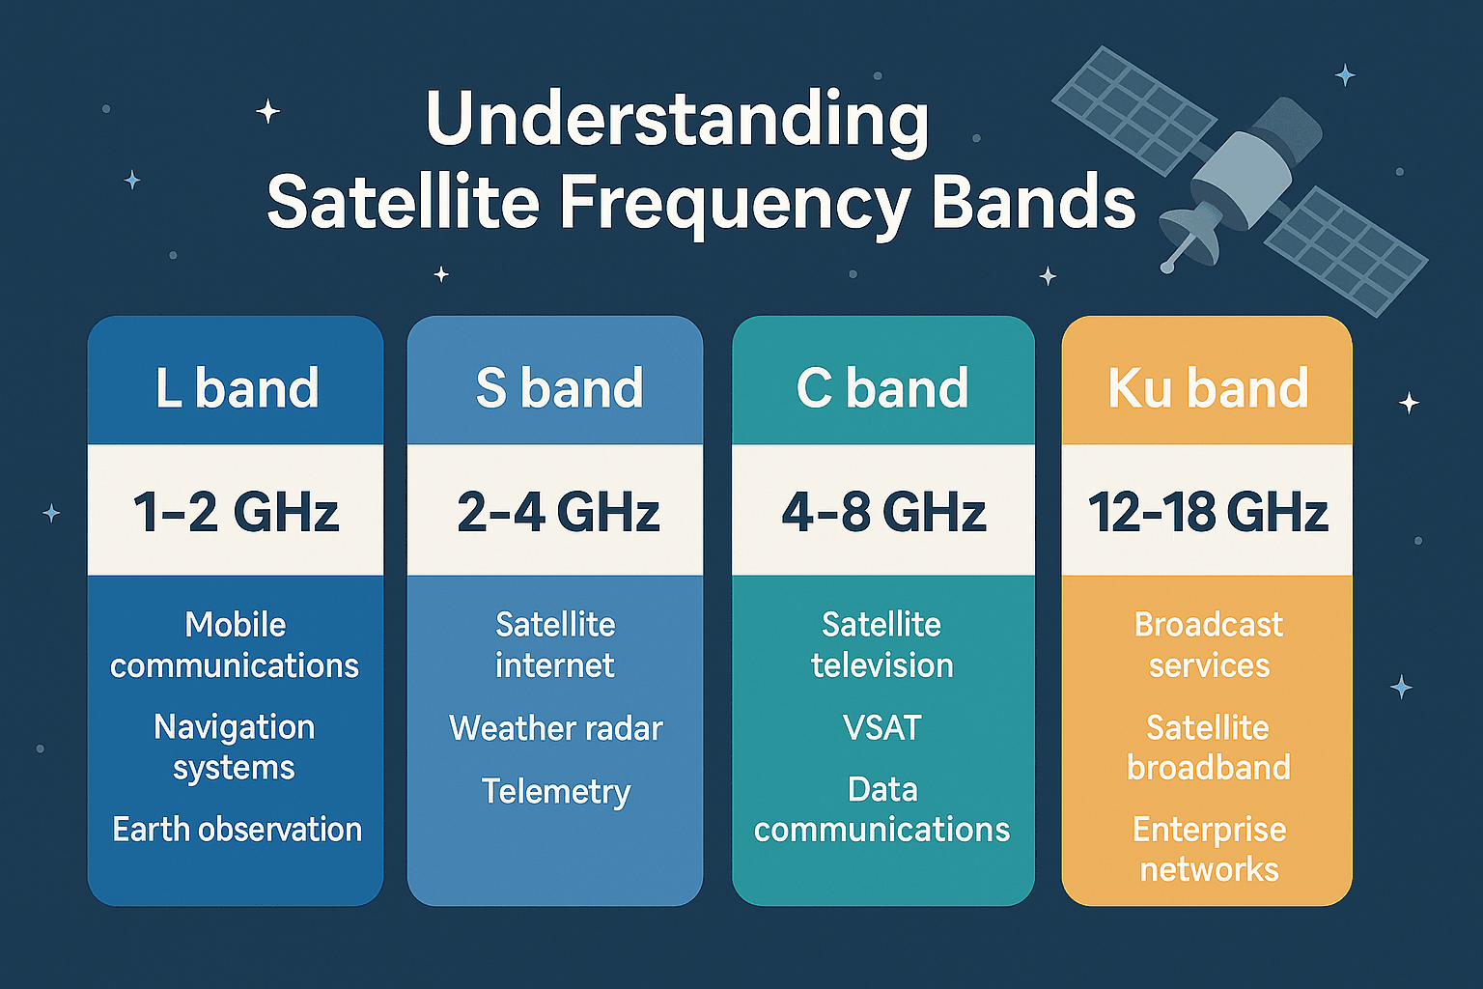
Satellite Bands
DMU HACKERS

Slide 10
Why is this relevant to us?
DMU HACKERS
Domain | Description | Relevance
Electronic Support (ES) | Passive detection and analysis of signals (SIGINT, COMINT, ELINT) | Network recon, OSINT, Wireshark packet sniffing
Electronic Attack (EA) | Active disruption (Jamming, Spoofing, EMPs) | Wifi jamming, GPS spoofing, malicious signal injection
Electronic Protection (EP) | Defending own EMS use (anti-jamming, encryption, hardening) | Secure comms, anti-jam protocols, frequency hopping, VPNs

Slide 11
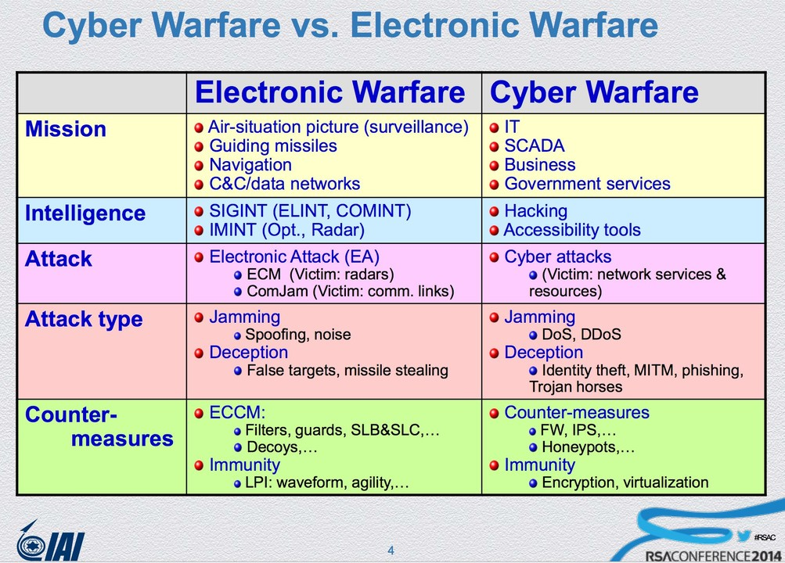
Why is this relevant to us?
DMU HACKERS

Slide 12

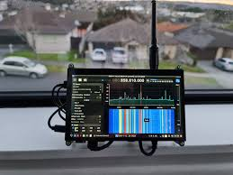
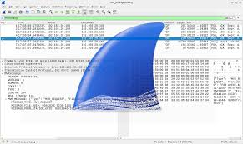
SIGINT Tools + Software
DMU HACKERS
SIGINT (Signals Intelligence) & COMINT
Interception of radio, cellular, satellite or Wifi traffic
Tools
SDRs (HackRF, RTL-SDR) for airwave monitoring
Wireshark for TCP/IP traffic analysis£60

Slide 13
What are we looking for?
DMU HACKERS
Traffic Pattern & Metadata Analysis
Anomalous spikes in data transfer
Unusual frequency usage
MAC Address spoofing
This correlates with OPSEC failures and adversary presence
For example…
Detecting a rogue device communicating at odd intervals on a military wifi channel

Slide 14
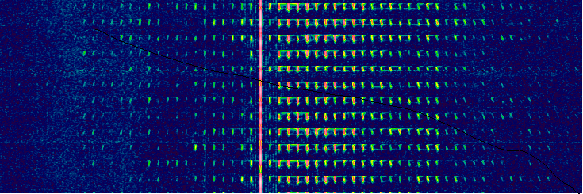
Conspiracy time…
DMU HACKERS
UVB-76:
Russian military designation frequency, that plays a buzzer sound on repeat (to prevent others using the frequency)
Sometimes a russian voice can be heard saying numbers, this was observed in 2023/4 although this is a cold war station… (spooky)

Slide 15
SIGINT and EW in the real world
DMU HACKERS
GPS Spoofing & Location-Based Deception
Common in tactical deception
GPS signals used to mislead autonomous systems, or trigger geo-fenced malware
Russian GPS spoofing around the Black Sea ports affects civilian ships (naughty putin)
Russian GPS jamming deprives northern Norway of its GPS availability (naughty x3)

Slide 16
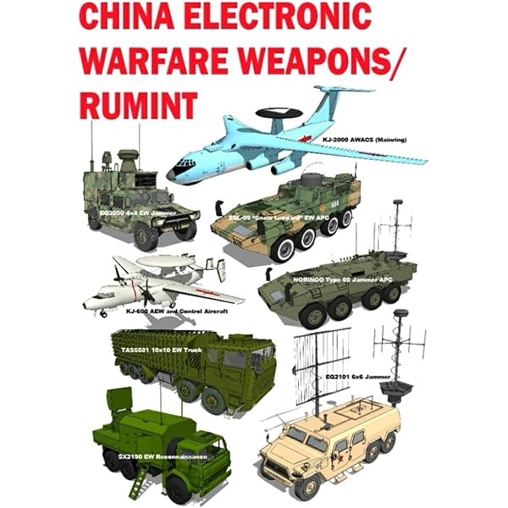
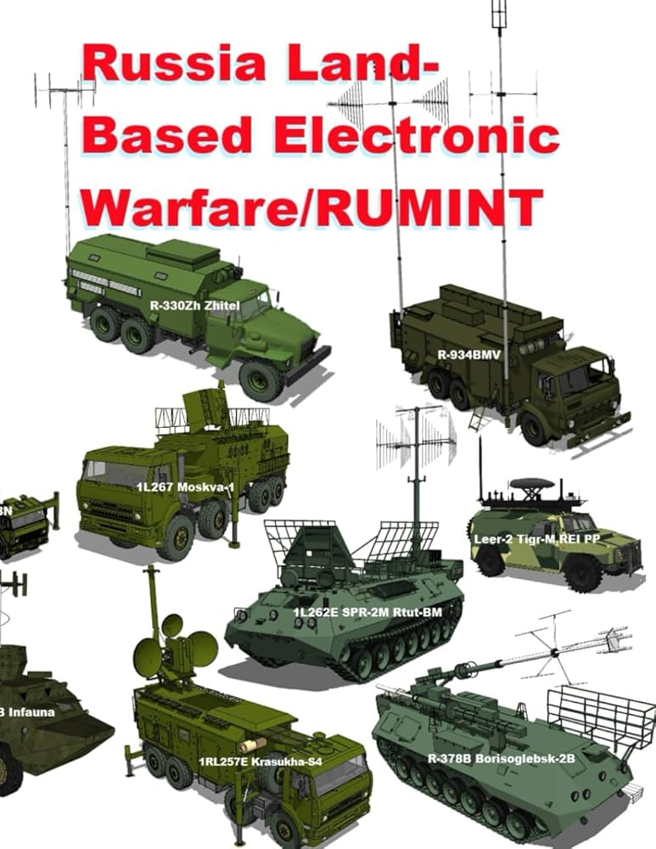
Adversarial EW Capabilities (mounted)
DMU HACKERS
£60

Slide 17
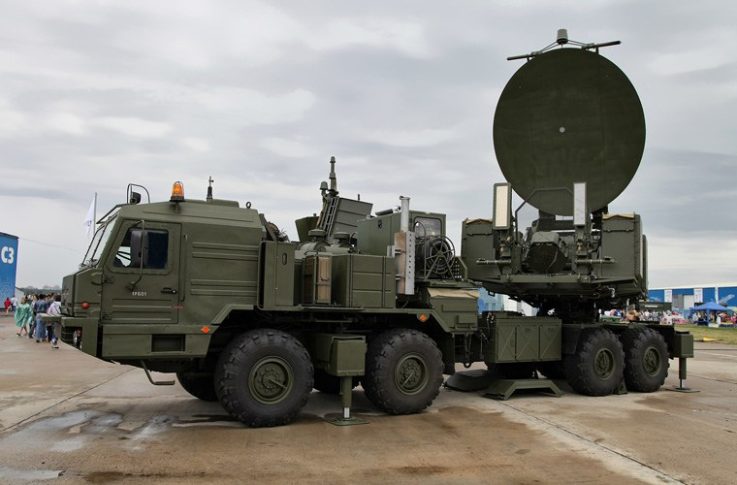
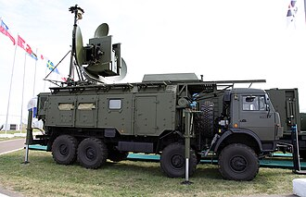
EW examples (Russo/Ukraine War)
DMU HACKERS
Krasukha:
Ground based EW system
Targets UAVs and radar guided systems
Krasukha-2:
S-Band system
AWACS Jamming
Krasukha-4:
Jamming station
X-Band / KU-Band
Counters JSTAR E-8 and similar
Can disrupt satellites in LEO

Slide 18
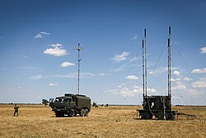
EW examples (Russo/Ukraine War)
DMU HACKERS
R-330ZH Zhitel:
GPS Jamming (Bloody annoying)
0.1-2 GHz range
Jams
Inmarsat
Iridium
GSM-1900 smartphones
NAVSTAR
Jams military and civilian comms

Slide 19
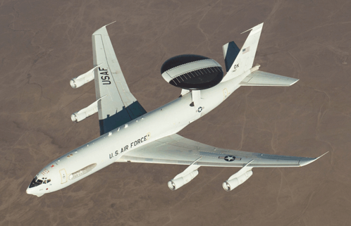

AWACS
DMU HACKERS
£0

Slide 20

Solution…
DMU HACKERS
£0

Slide 21
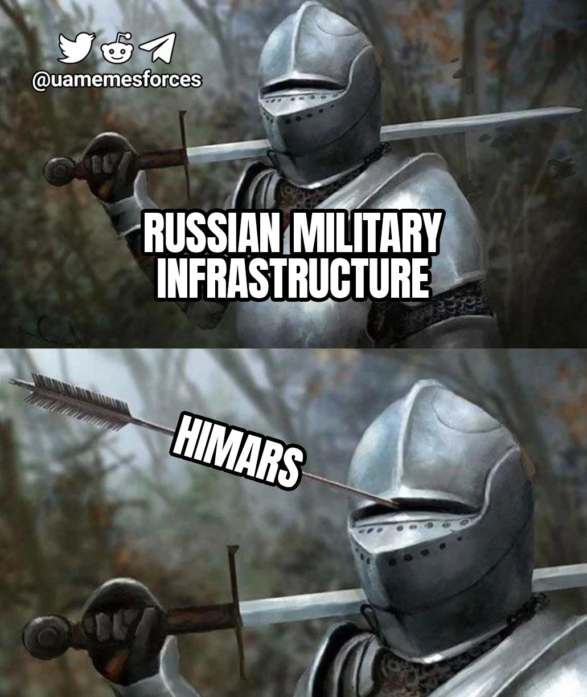
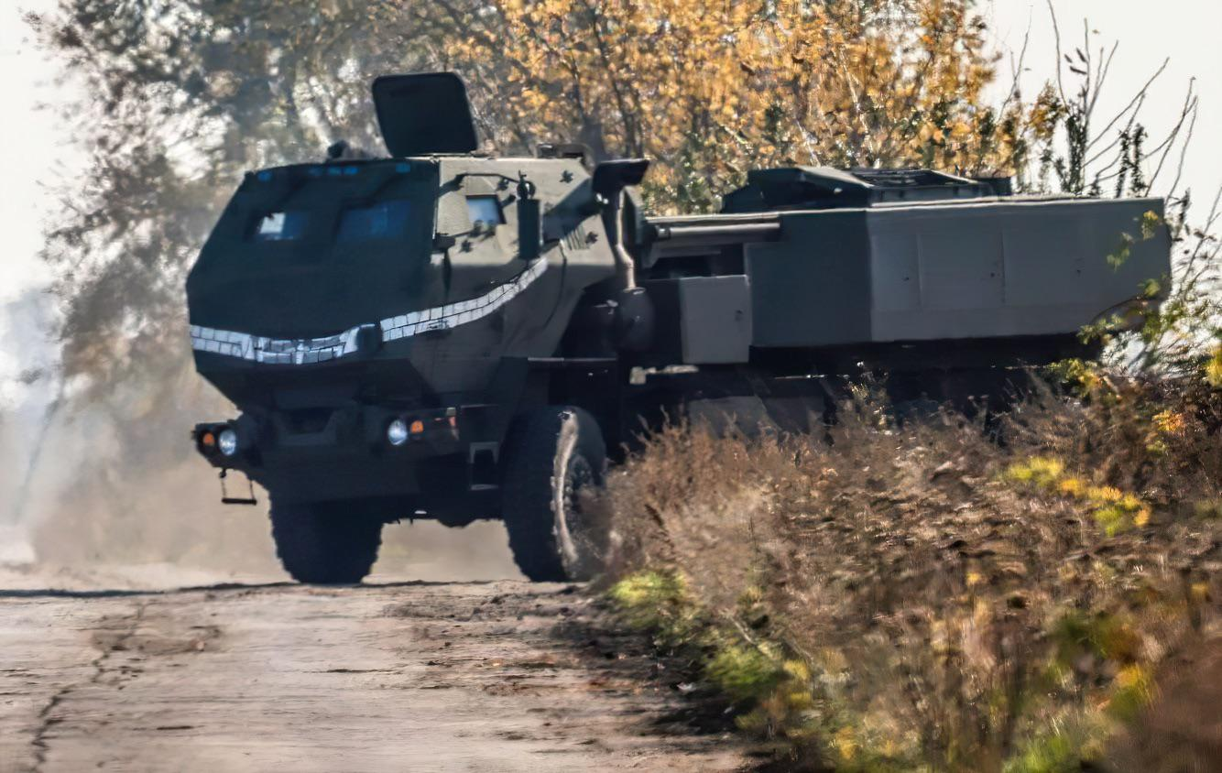
HIMARS
DMU HACKERS
The Zhitel can also effect the accuracy of HIMARS strikes, which has forced the US to modify the software for the GMLRS rockets fired by HIMARS

Slide 22
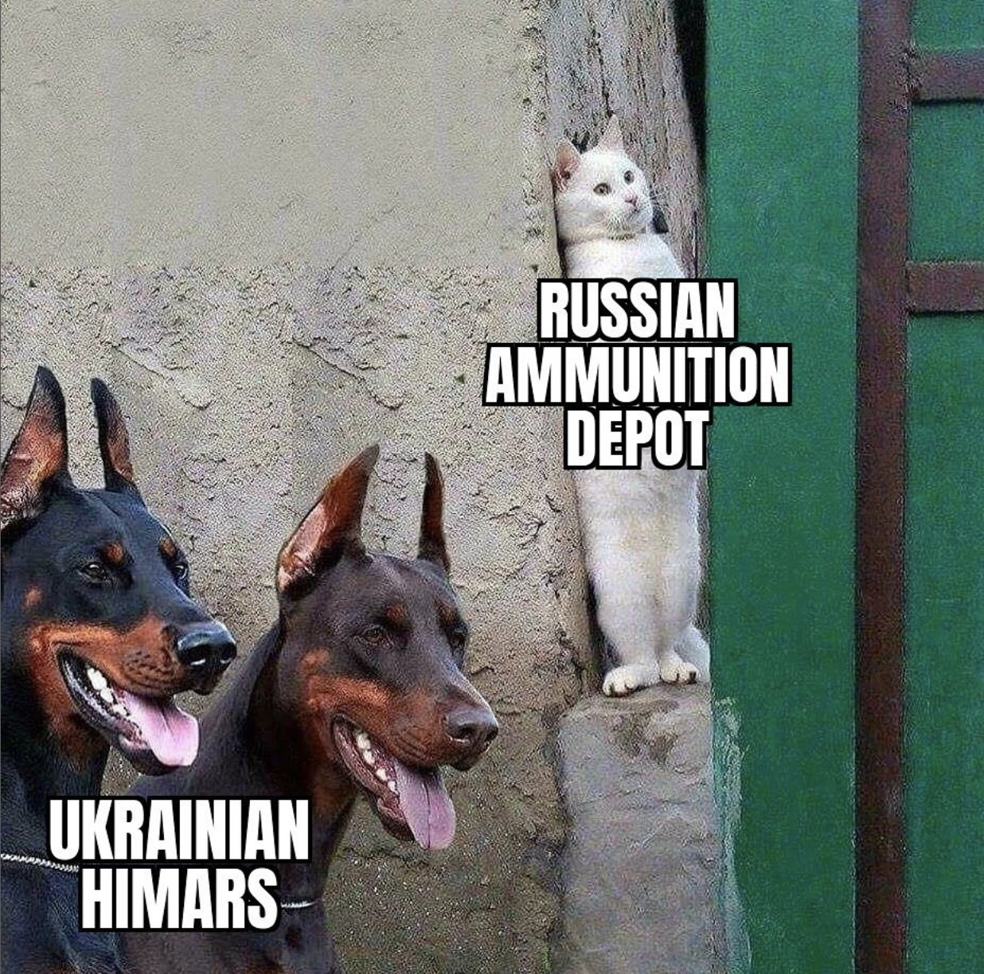
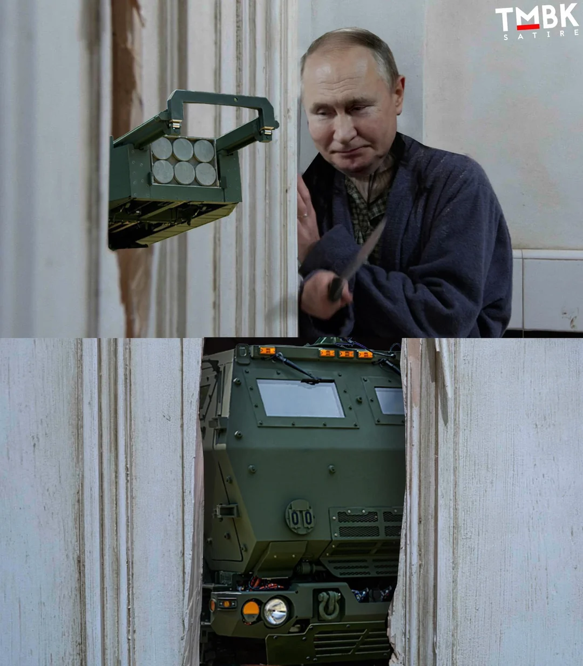
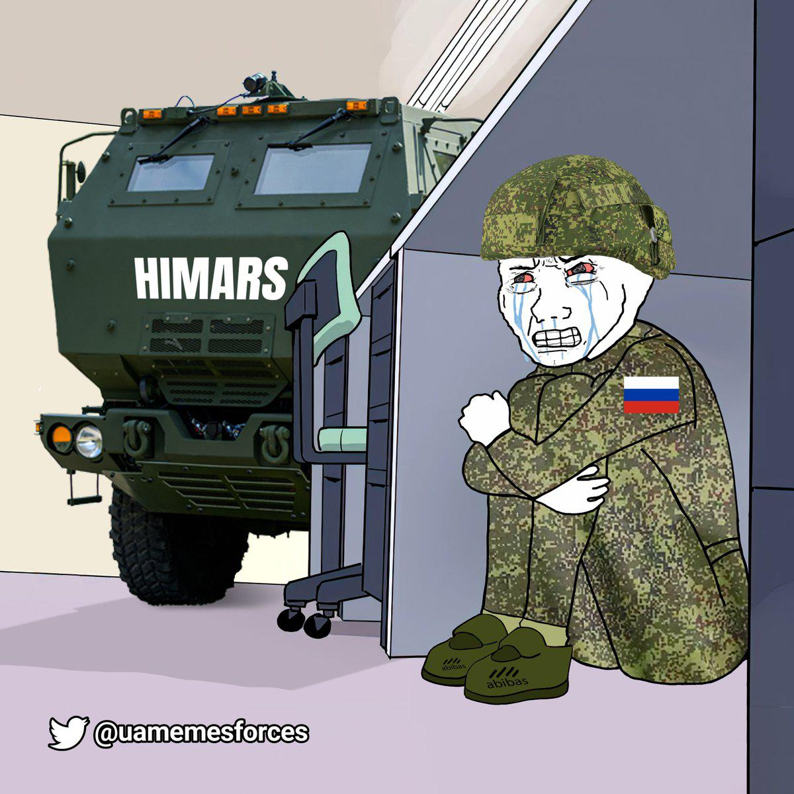
Solution…
DMU HACKERS
£0

Slide 23
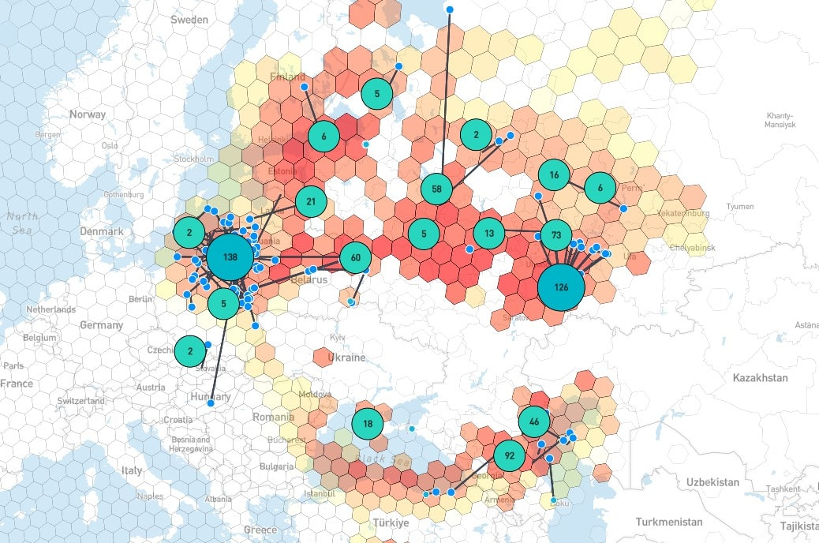
Current GPS Jamming
DMU HACKERS
£0

Slide 24
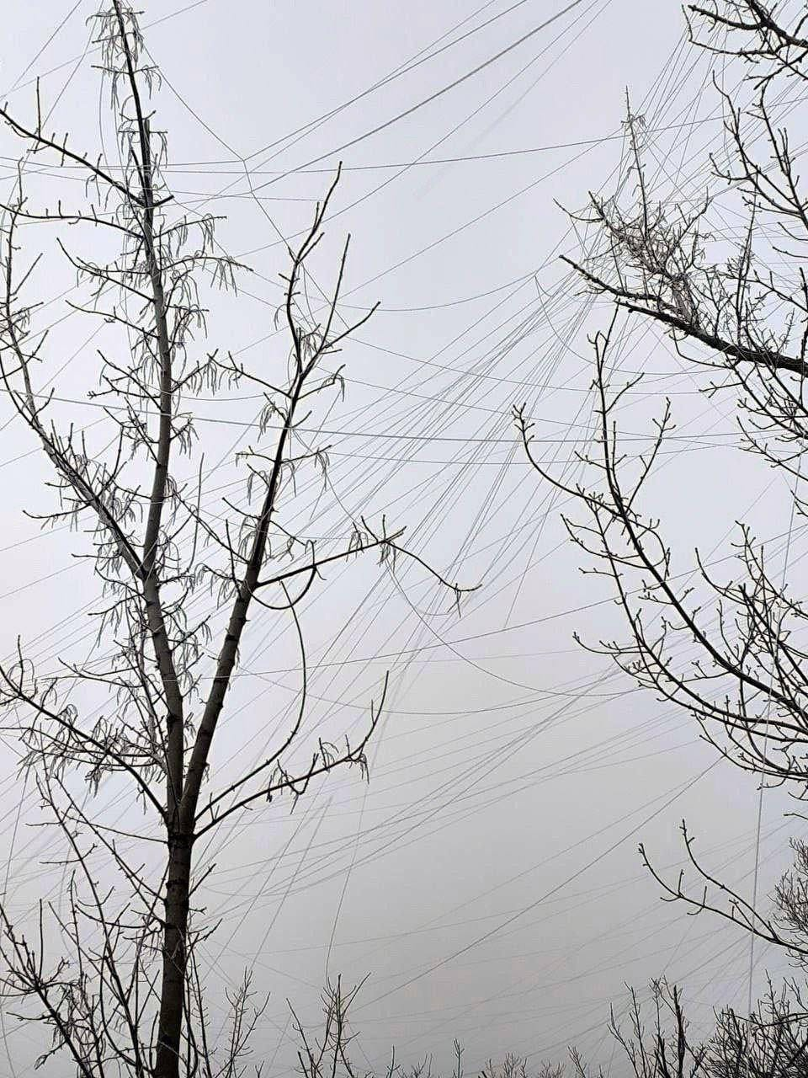
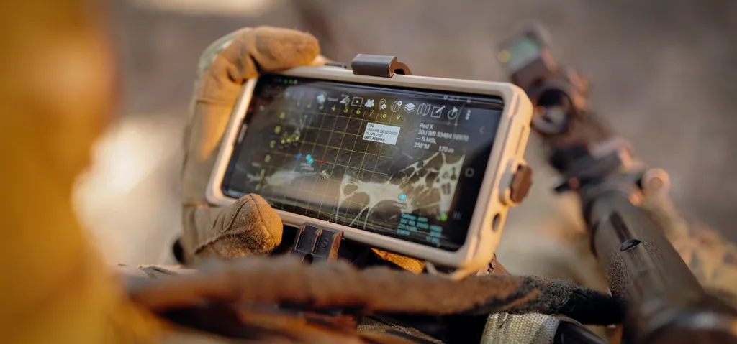
Modern warfare and the role of cyber
DMU HACKERS
Data war
UAVs and IEDs
Future Soldier
Anyone know what these are?

Slide 25
EW in practice…
DMU HACKERS
Jamming and Denial-of-Spectrum (DoS-EW)
Similar to DoS/DDoS (Denial of Service)
Prevents legitimate comms (wifi, satcom)
Often combined with cyber intrusions to blind response efforts
Using deauth packets (aireplay-ng) to force re-authentication and capture WPA handshakes… We will cover this in WiFi hacking 101

Slide 26
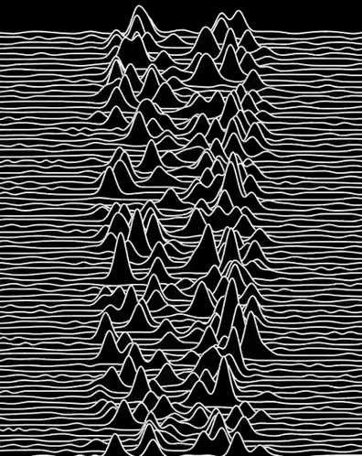
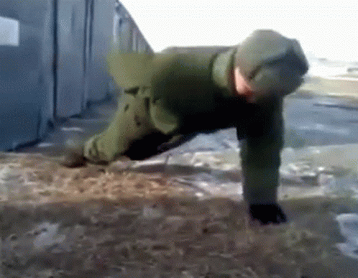



EW in practice…
DMU HACKERS
£60

Slide 27
Why does any of this matter?
DMU HACKERS
The fundamental points of compromise here to military EMS is very similar to a corporate network
(you may one day defend as a Blue Team warrior)
EW Defence | Cyber Similarity
Frequency Hopping | VPN tunnelling, domain fronting
Spread Spectrum | Data obfuscation
Shielding (Faraday cages) | Network segmentation, air gapping
Signal Encryption | End-to-end encryption (TLS, PGP)

Slide 28
Wireshark
DMU HACKERS
Wireshark is a free, open-source network protocol analyser that allows us to visualise packet-level data on a network
It is primarily used for:
Threat Hunting
Malware Analysis
Network Troubleshooting
Training in SIGINT & EW

Slide 29
Wireshark
DMU HACKERS
Key points:
A packet is a basic unit of data that is transmitted over a network
Protocols (TCP, UDP, LDAP, ARP, ICMP)
Capture vs Analysis
What is a filter?
What is a frame, packet, segment, datagram (OSI Model)

Slide 30
Wireshark
DMU HACKERS
Use case | Filter
See only http | http
Filter by IP | Ip.addr == 192.168.1.10
Only TCP traffic | tcp
Show DNS queries | dns
Follow conversation stream | Tcp.stream eq 1

Slide 31
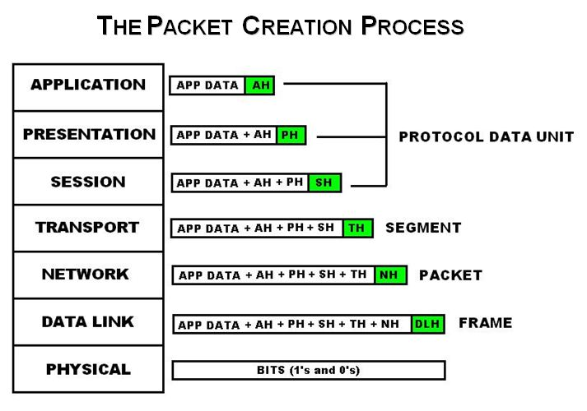

Slide 32
Packets
DMU HACKERS
Header:
Where its from, where its going, what protocol is it using
Payload:
The data being transmitted… (webpage, file, message etc..)
Trailer:
Used for error checking (optional)

Slide 33
File Transfer
DMU HACKERS
Let's say we wanted to transmit a PDF via FTP (insecure), the average size of a PDF document is between 100KB and 5MB…
Packets used in FTP transfers are usually around 1500 bytes total size, and therefore we will need to split our PDF down into chunks to be sent via packets… So how do we reassemble it on the other end…
Each packet will have a start and end line showing where the PDF continues from and stops, this allows the packets to be sewn back together into one file as it originally was.

Slide 34
File Transfer
DMU HACKERS
I have tried to manually reassemble a file from packets once
(wouldn’t recommend)
Luckily, wireshark speeds this process up for us by allowing us to export the file as an object, we do this by going to…
File → Export Objects → HTTP (if this is the protocol) → Select the file → Download it :)

Slide 35
Verify file integrity
DMU HACKERS
How do we know we have rebuilt the file correctly?
HASHED CHECKSUMS
Hashing Algorithms like MD5 have been considered insecure for many years but still work to produce a valid checksum of a file, if one character in the file changes we will get a completely different hash output, we can check a file integrity via the command:
md5sum “file”.txt If our original hash matches the hash of the file we receive post transmission, success! If not, either we have a MITM or issues with our software

Slide 36
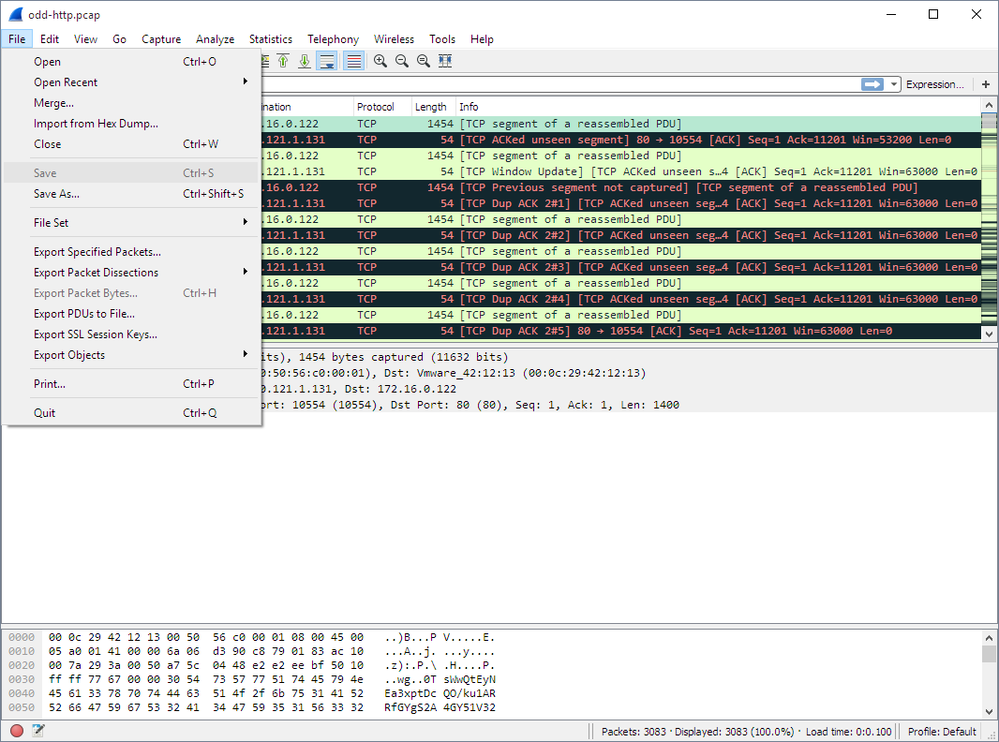
Wireshark

Slide 37
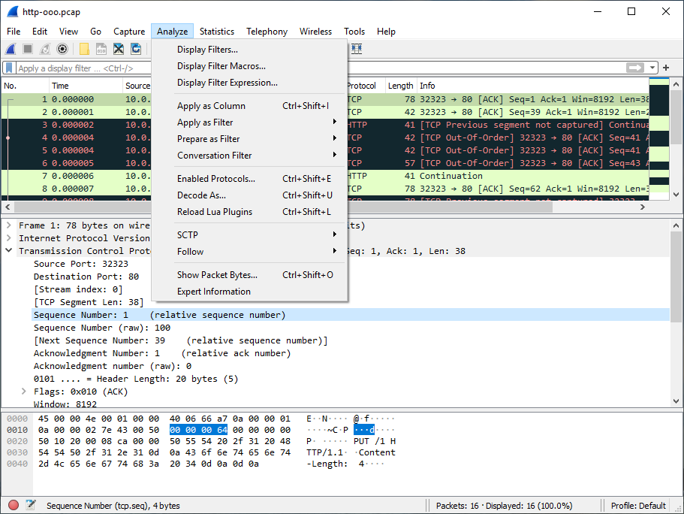
Wireshark

Slide 38
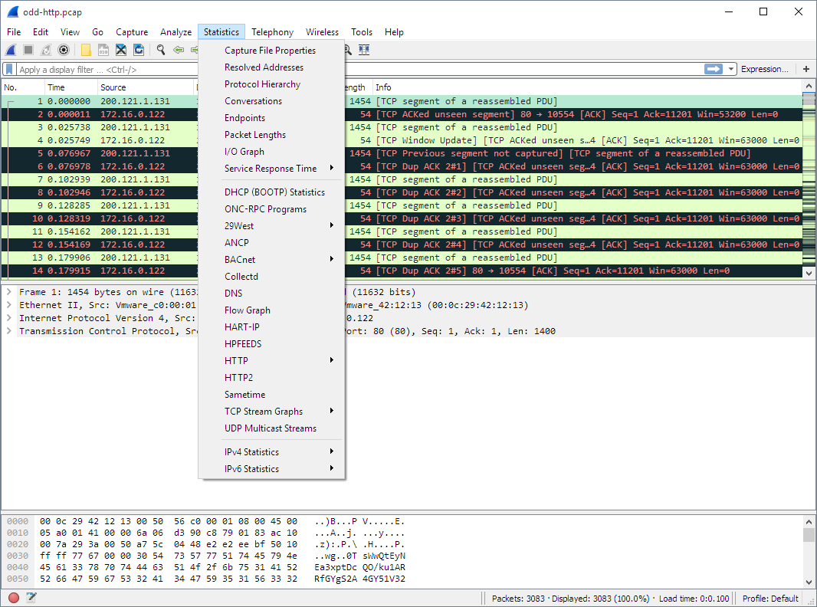
Wireshark

Slide 39
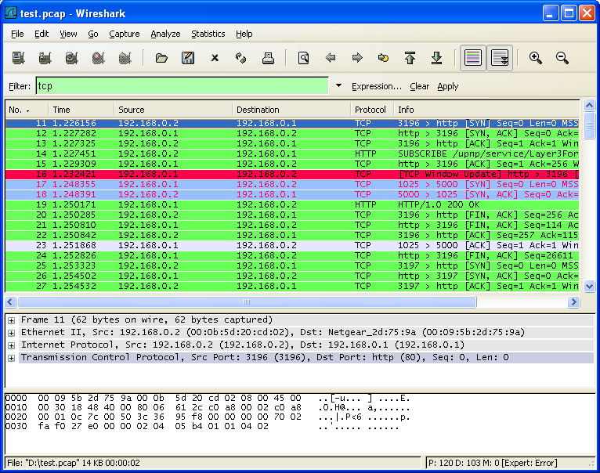
Wireshark

Slide 40
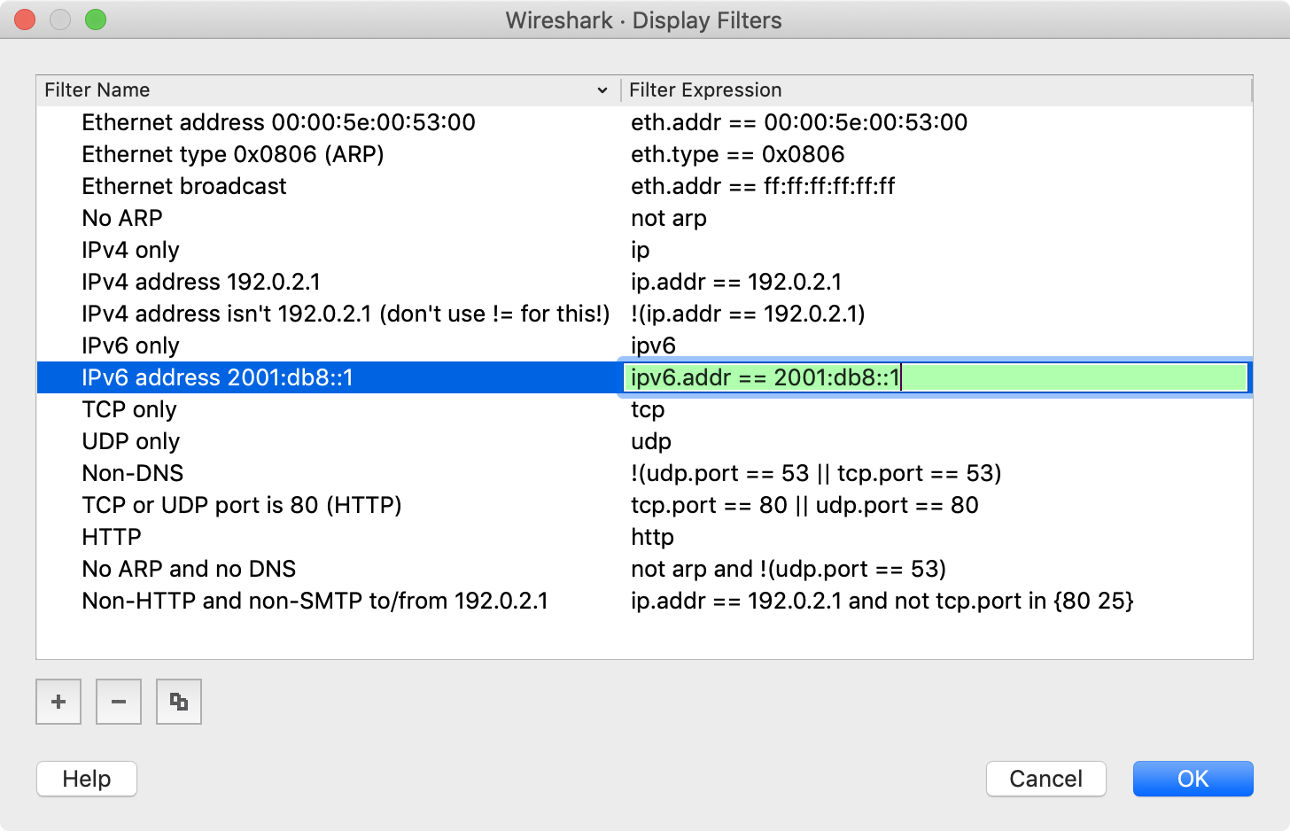
Wireshark

Slide 41
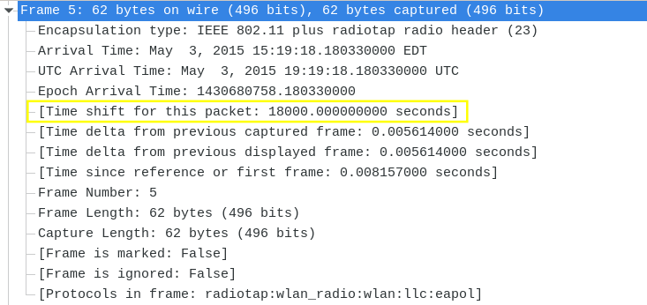
Wireshark

Slide 42
Wireshark in the world
DMU HACKERS
Blue Team:
Detect exfiltration or C2
Red Team:
Confirm payload delivery
Scope network
EW Support Team:
Passive collection (soak) of enemy network behaviour
Target ID via MAC/IP/Signal Correlation

Slide 43
Wireshark drawbacks
DMU HACKERS
We cannot decrypt encrypted traffic without keys or other methods
Can’t detect all wireless traffic without “monitor mode”
Best used in combination with:
IDS/IPS - Snort/Suricata
EW Gear (SDRs, RF jammers)

Slide 44
Summary
DMU HACKERS
Wireshark is essential for network intelligence
Filters are your friend…
.pcap files are battlefield black boxes!
Use this practical to really deep dive into wireshark and TCP/IP
It will seem alien at first but give it time…

Slide 45

The Practical
DMU HACKERS
https://tryhackme.com/room/c2carnage

Slide 46
UVB-76
DMU HACKERS
http://websdr.printf.cc:8901/

